Slide 1

Airbnb property Clustering with unsupervised machine learning Springboard Data Science Capstone Project
Travis Martin

Slide 2

Problem Statement
Stakeholder: airbnb
Vacation rental company founded in 2008
Robust system of property and user ratings
Grown to over 7M listings in 100,000 cities worldwide
Business Problem
The purpose of this project is to identify meaningful clusters of Airbnb properties based on more than just physical location, and to provide Airbnb with recommendations on how to leverage the resulting clusters.
For this analysis, I used owner-provided features, amenities lists, and text descriptions, along with Natural Language Processing and an unsupervised clustering model (KMeans) to group similar properties.

Slide 3

Dataset and Scope
Came from a Kaggle competition based on predicting listing prices
Base form: 74K rows and 29 feature columns, 6 US cities (NYC, LA, SF, Chicago, DC, and Boston)
To hopefully create more meaningful clusters, restricted the data to NYC area and “entire home/apt” rentals only (eliminating private and shared rooms).
Left with 16,243 unique properties
3 rough groups of data for each listing:
“Base” columns – include information like # accommodated, # of reviews, zip code, neighbourhood
“Amenity” column – dictionary containing all amenities the owner selected from pre-defined list.
“Text” columns – Name and Description. Owner generated text fields. Limited only by a character limit and a content filter.

Slide 4




Data Wrangling – Base Columns
Null-values
bathrooms – dropped 2 properties with confirmed no bathroom on site; assigned rest to 1.0 (86% of listings)
host_has_profile_pic - 80 null values, reassigned to "False". Column converted from string to boolean.
host_identity_verified - 80 null values, reassigned to "False". Column converted from string to boolean.
host_response_rate - ~5k nulls, replaced with average of non-null records.
review_scores_rating - ~500 nulls, replaced with average of non-null records.
beds - Assumed 1:1 bedroom:bed relationship and copied over value from ‘bedrooms’ column.
Used zip code lists found online to create a new column assigning each property to its corresponding NYC borough (Manhattan, Brooklyn, Bronx, Queens, or Staten Island)
zipcode - Used reverse geocoding (GeoPy) to populate missing values (and replace improperly coded zips) based on lat/lon coordinates.
thumbnail_url - converted into a boolean column 'has_url'
neighbourhood - had as many unique records as zipcode, making it redundant. Column dropped.
first_review and host_since
Converted from string to Datetime column
Created a 'today' datetime variable 1 day after the max value of the 'last_review' column, assigned this value to all nulls in the column
Created a new 'days_since_first_review' column that calculated the timedelta between 'today' and 'first_review' in days
Created a new 'days_since_host_start' column that calculated the timedelta between 'today' and 'host_since' in days
‘host_since’ and ‘first_review’ columns dropped

Slide 5
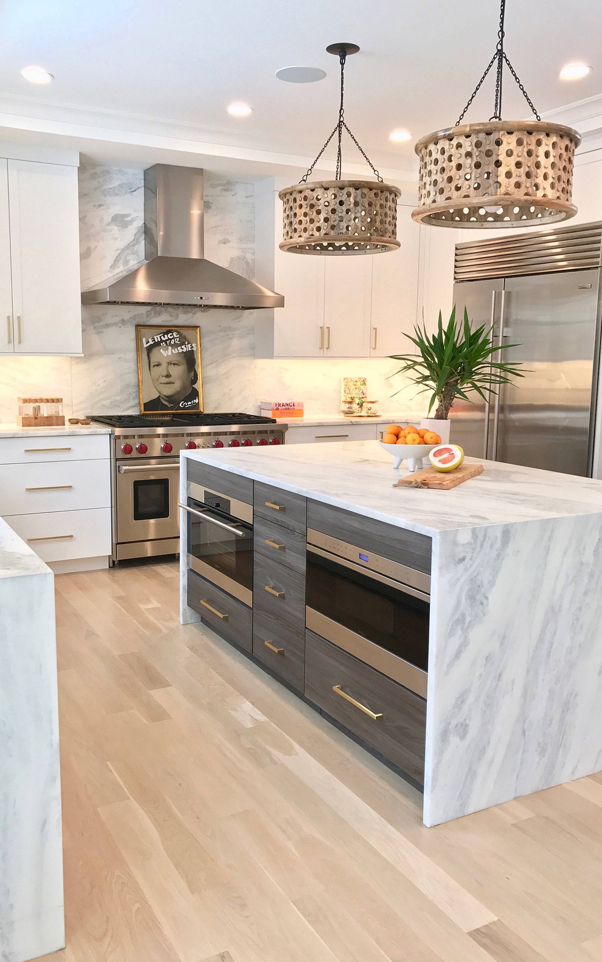
Data Wrangling – Amenities Column
116 unique amenities present in the dataset.
To make the analysis more targeted and reduce dimensionality, I assigned each amenity to one of three basic categories. I leveraged the first group and ignored the other two.
Targets (38) - Amenities likely to affect clustering behavior. Present in sufficient numbers in the source data. (Ex: Washer/Dryer, Oven/Stove, Kid-friendly, Doorman, Pool, Gym)
Givens (65) - Amenities either considered a given in a short-term rental (Ex: Smoke Detector, Shampoo), or are small enough upgrades that they will likely not measurably impact clustering behavior (Ex: First aid kit, Outlet covers)
Exclusions (13) - Amenities which could potentially drive clustering behavior but are extremely low in number (Ex: EV Charger) or inappropriate for the NYC market (Ex: Ski in/Ski out).
Created binary columns for each of the 38 target amenities

Slide 6


Data Wrangling – Text Columns (NLP)
description and name - The owner-generated property descriptions and property names.
I performed Natural Language processing on these two columns using the nltk Python library. The general process followed for 'description' and repeated for 'name' was:
Converting all characters to lower-case only
Tokenize the column, creating a new column where each row contains a list with every word in the description as a separate string.
Lemmatize the tokenized word lists, replacing all forms of a given word with its root word (ex: rides/riding/rode -> ride)
Filtering for "stop words" - Base English stop words dictionary includes words like "the", "and", "of", (common and don't add to the meaning of a sentence). Added filters for common characters like "&" and "...", which the tokenizer treats as words.
Creating a new column for word count of the filtered descriptions/names
Calculate and plot word frequencies using a flattened list of all words in all descriptions.

Slide 7
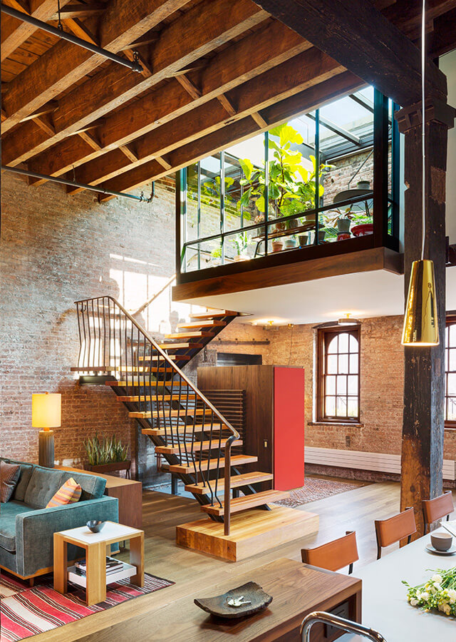
Data Wrangling – Text Columns (NLP)
Using the word frequency list and my own knowledge, I created 23 new word groupings based on similar meanings or sentiments:
I populated each of these lists with words from the descriptions (and variations thereof), and even added synonyms not included to start building a knowledge-base independent of this specific dataset.
Created new columns counting how frequently words from the group lists appeared in each listing's description (23 new columns).
"Big” words
"Small" words
"Public transit" words
"Landmark" words
"Nightlife" words
"Business" words
"Safety" words
"View" words
"Updates" words
"Cleanliness" words
"Tourism" words
"Relaxation" words
Ex: "spacious", "roomy", "wide"
Ex: "cozy", "narrow", "minimalist"
Ex: "subway", "station", "buses"
Ex: "MOMA", "empire", "Chinatown"
Ex: "bars", "restaurants", "comedy"
Ex: "desk", "laptop", "printer"
Ex: "alarm", "safe", "secure"
Ex: "overlook", "panorama", "picturesque"
Ex: "restored", "upgraded", "remodeled"
Ex: "pristine", "uncluttered", "immaculate“
Ex: "getaway", "tours", "attractions“
Ex: "oasis", "soothing", "quiet"
"Family" words
"Proximity" words
"Romance" words
"Luxury" words
"Culture" words
"Ease" words
"Hip" words
"History" words
"Nature" words
"Retail" words
"Negative" words
Ex: "family-friendly", "child-proof", "toys“
Ex: "walkable", "blocks", "minutes“
Ex: "romantic", "anniversary", "couples“
Ex: "luxurious", "high-end", "designer"
Ex: "cultural", "galleries", "community“
Ex: "convenient", "accessible", "automatically”
Ex: "hipster", "stylish", "trendiest"
Ex: "Pre-war", "classical", "original"
Ex: "parkside", "tree-lined, "greenery"
Ex: "CVS", "supermarket", "boutiques"
Ex: "filthy", "cramped", "chaotic"

Slide 8
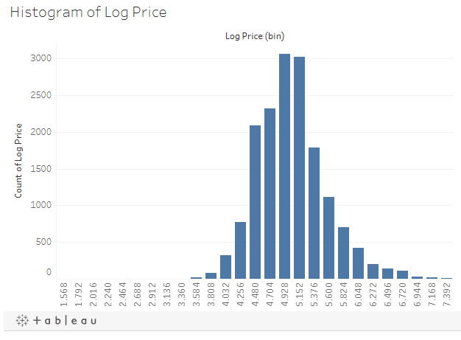
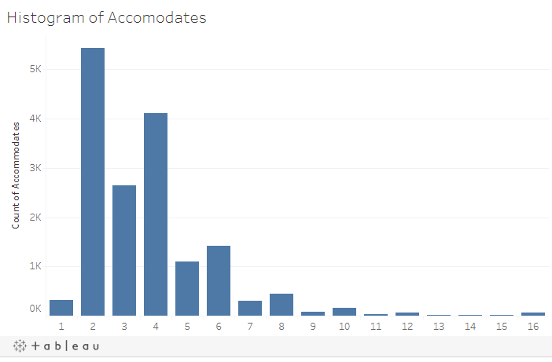
Exploratory Data Analysis – Base Columns

Slide 9
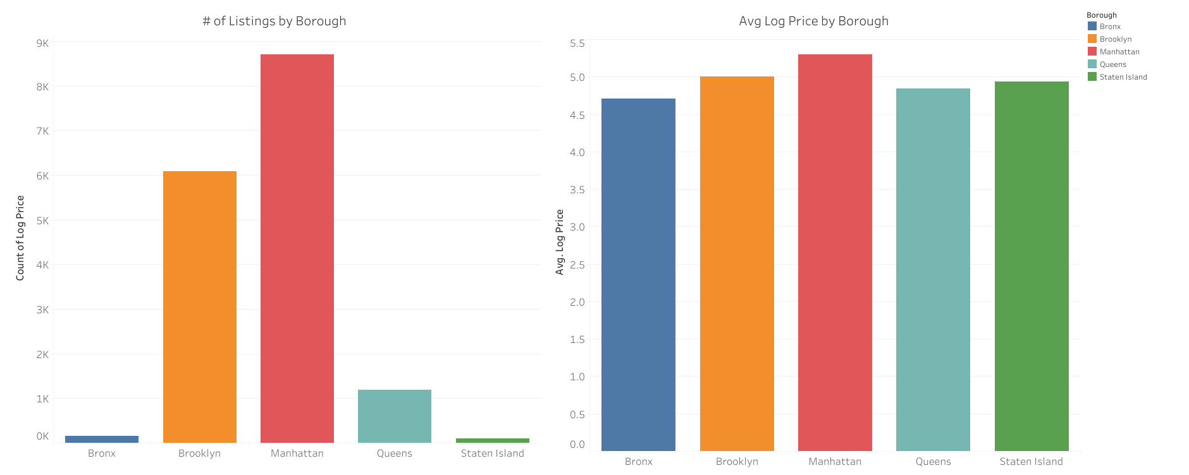
Exploratory Data Analysis – Base Columns

Slide 10
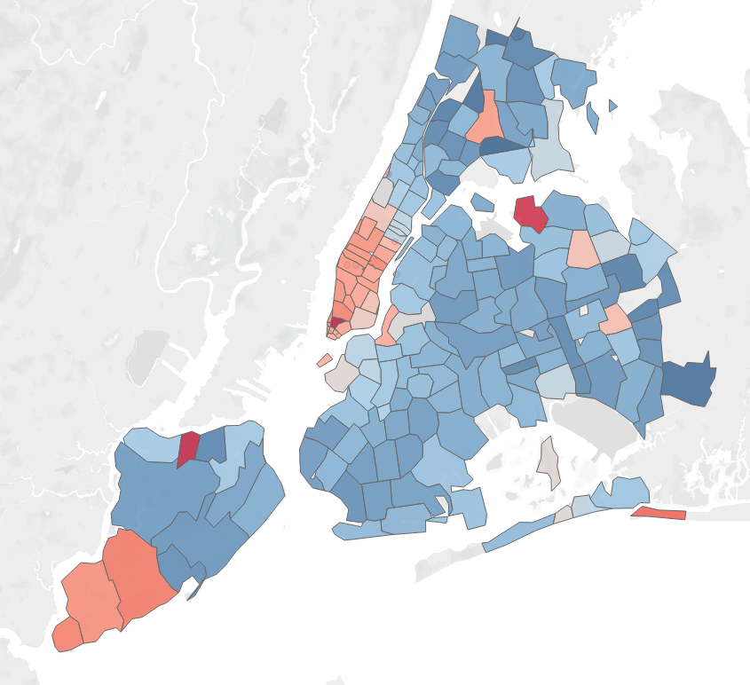
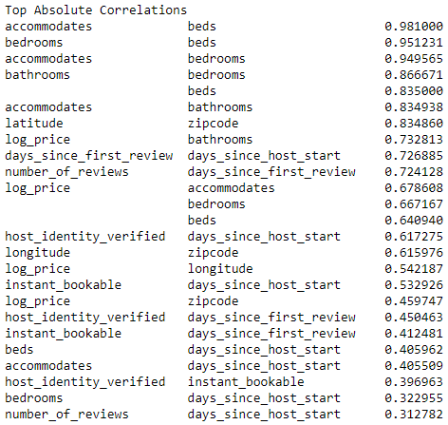
Exploratory Data Analysis – Base Columns
Avg Log Price by Zip Code

Slide 11
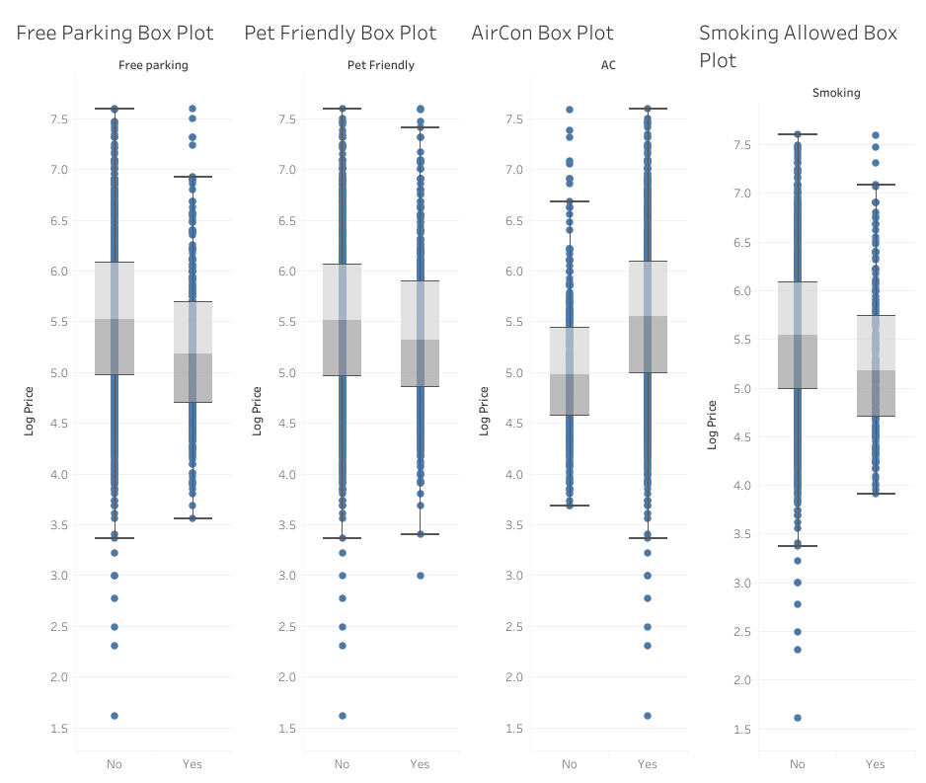
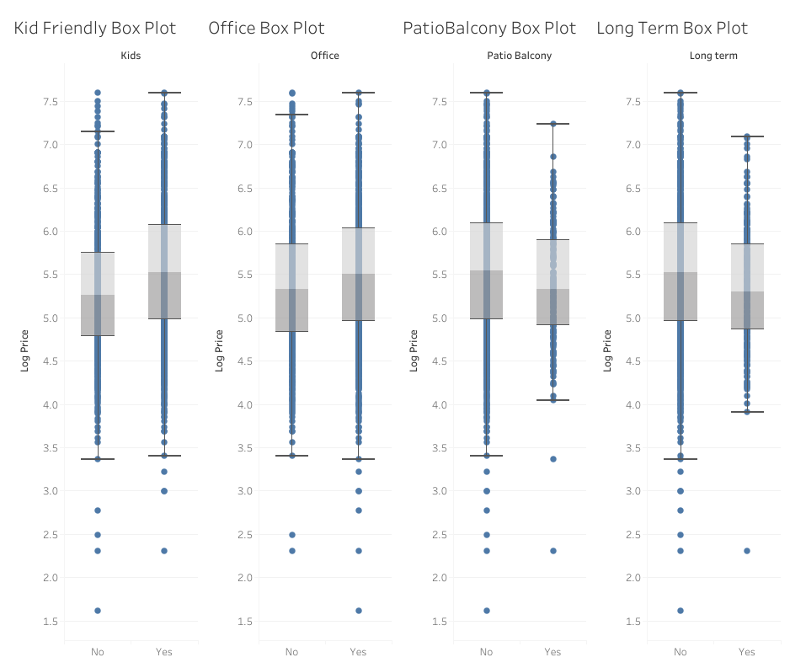
Exploratory Data Analysis – Amenity Column

Slide 12
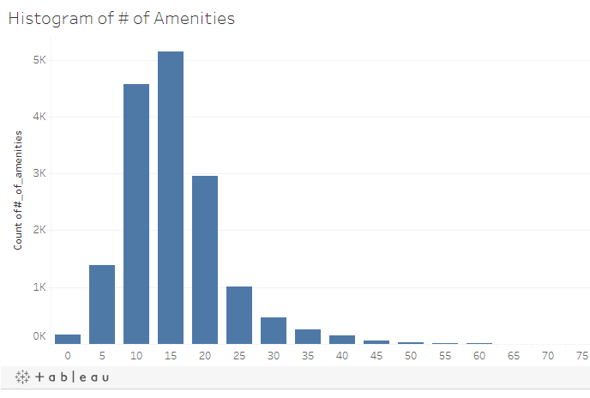
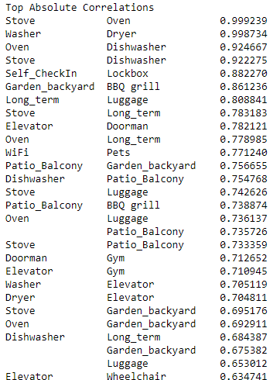
Exploratory Data Analysis – Amenity Column

Slide 13
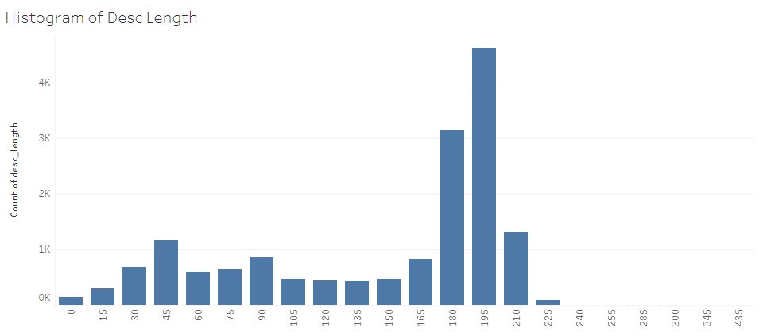
Exploratory Data Analysis – Text Columns

Slide 14
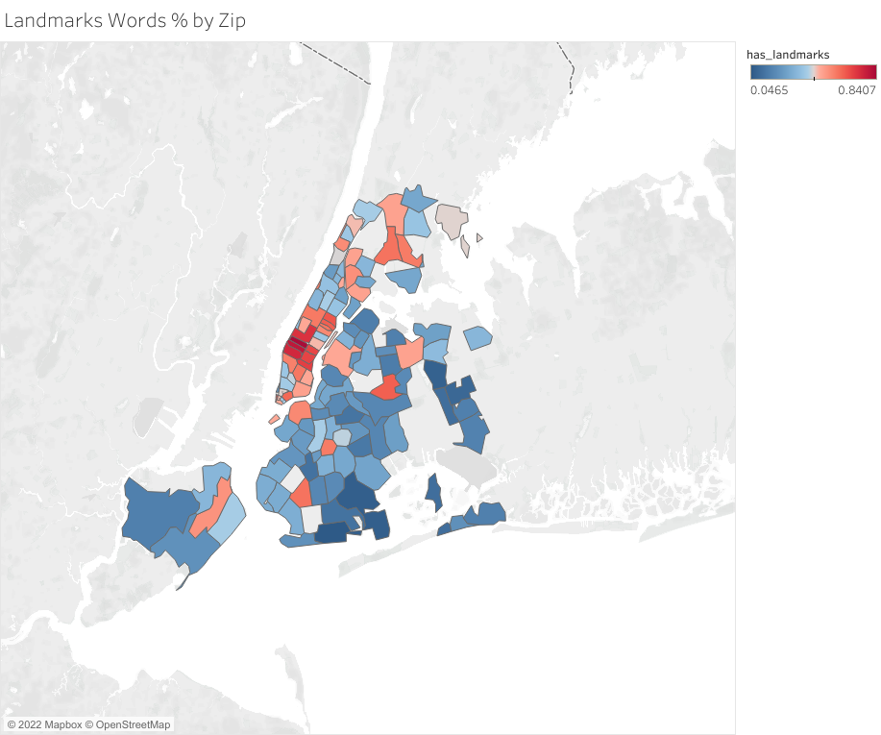
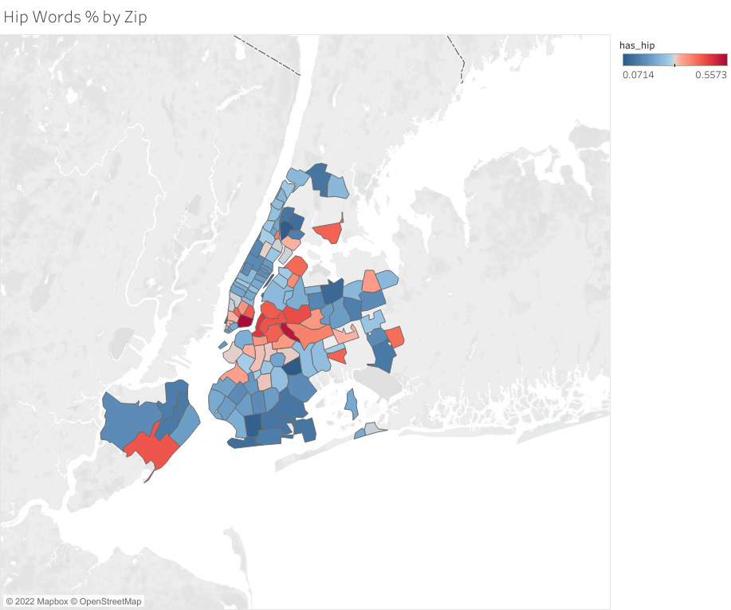
Exploratory Data Analysis – Text Columns

Slide 15
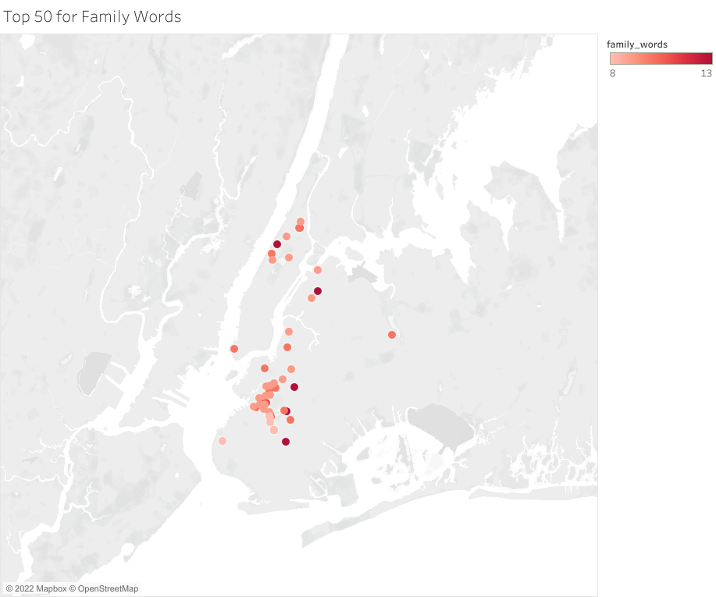
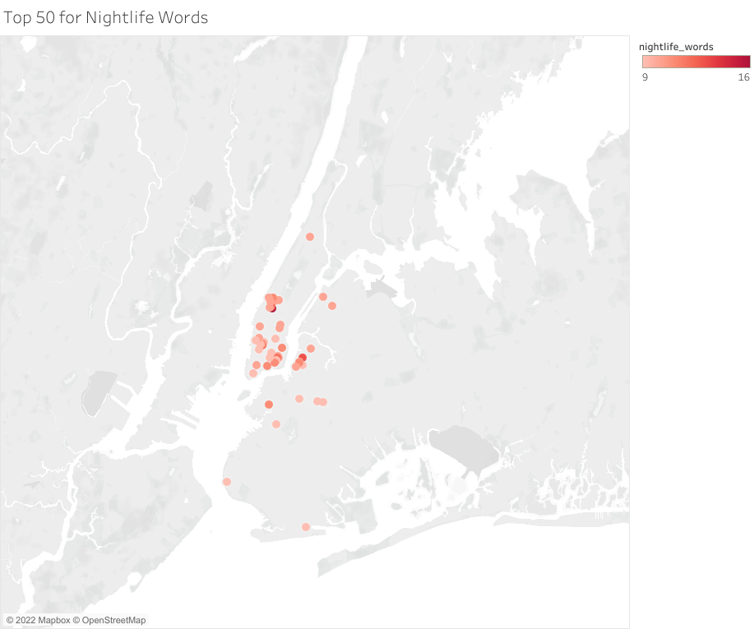
Exploratory Data Analysis – Text Columns

Slide 16
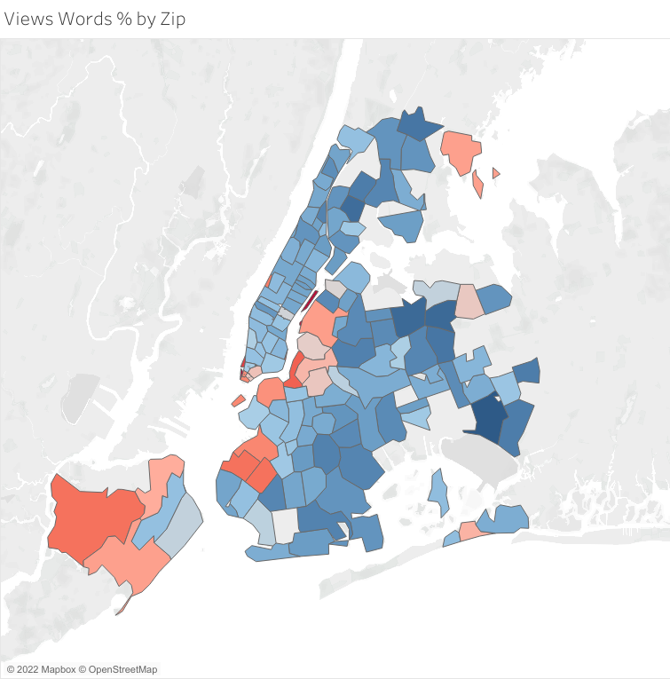
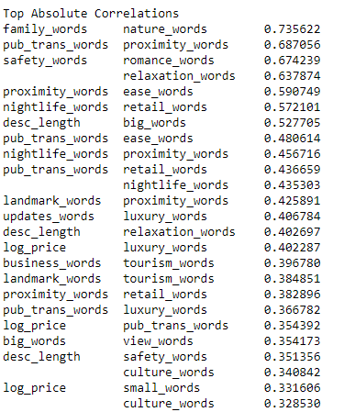
Exploratory Data Analysis – Text Columns

Slide 17
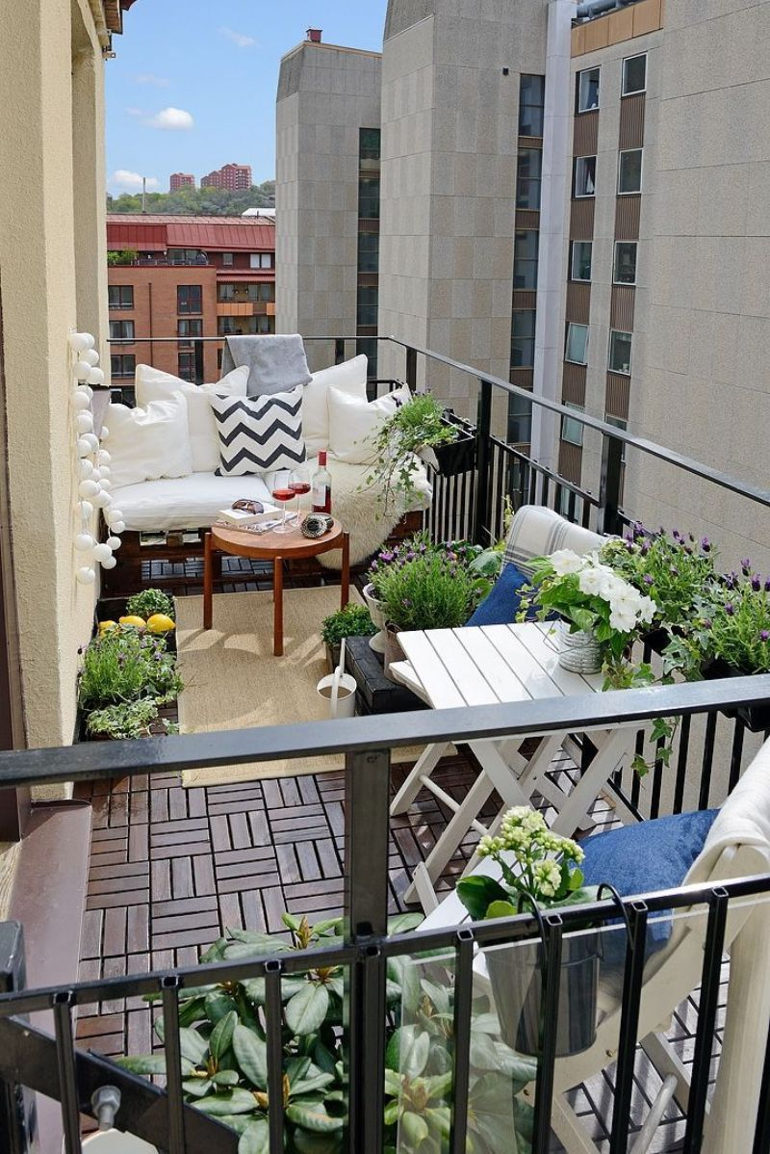
Preprocessing
Preprocessing in preparation for unsupervised clustering with KMeans for this dataset involved the following actions:
Dropping unneeded columns like "neighbourhood" (redundant with zipcode) and "id" (unique identifier unnecessary for prediction)
Trimming down "property_type" entries to just the top 6 most common (Apartment, House, Loft, Townhouse, Condominium, and Other). This involved re-casting rare types like "cabin", "yurt" and "villa" to "Other".
Converting 'bed_type', a categorical column with 5 categories to a simple 'real_bed' 0/1 column. (Real bed accounted for over 98% of records)
Re-classing the 10 properties with "super_strict_30" or "super_strict_60" as their cancellation policy to simply "strict", cutting out the need for 2 dummy columns.
After this process was complete, I was left with a total of 94 numerical feature columns.

Slide 18
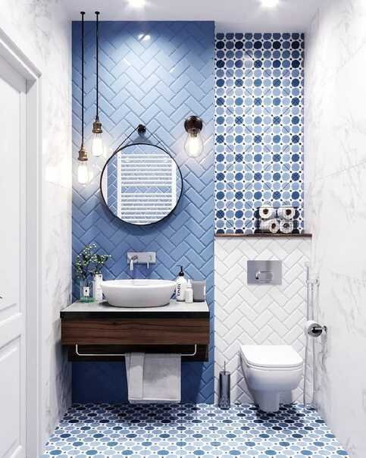
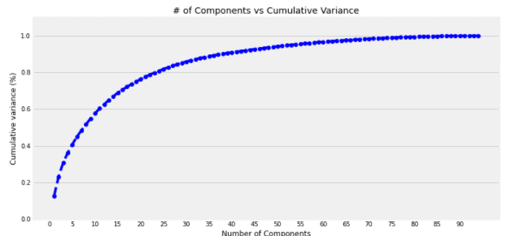
Preprocessing
Ran the following in parallel using a Pipeline object:
Scaling the data using StandardScaler()
Feature reduction using Principal Component Analysis
Necessary because of the high correlations between some variables
Used % of explained variance chart and Kneed to optimize (25 principal components)

Slide 19
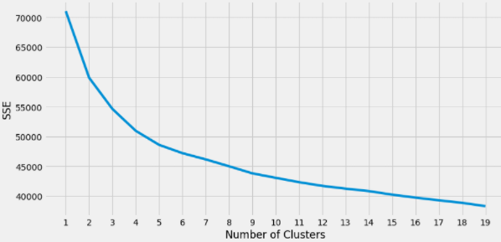
Modeling – KMeans Clustering
First step was tuning # of clusters:
Used chart of SSE vs cluster # and Kneed to optimize (5 clusters)

Slide 20
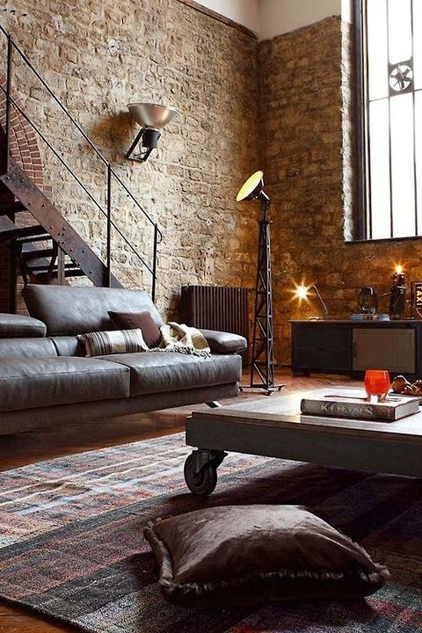
Modeling – KMeans Clustering
Fit the model to the data using optimal parameters
Silhouette score (measure of intra-cluster density and cluster separation) was 0.152 for this clustering model. With a scale of possible values between -1 and 1, this was an acceptably positive result.
The distribution of properties between the new clusters was as follows:
Cluster 0 - 4279
Cluster 1 - 4734
Cluster 2 - 2479
Cluster 3 - 1279
Cluster 4 - 3471
Assigned returned cluster labels to original dataset

Slide 21
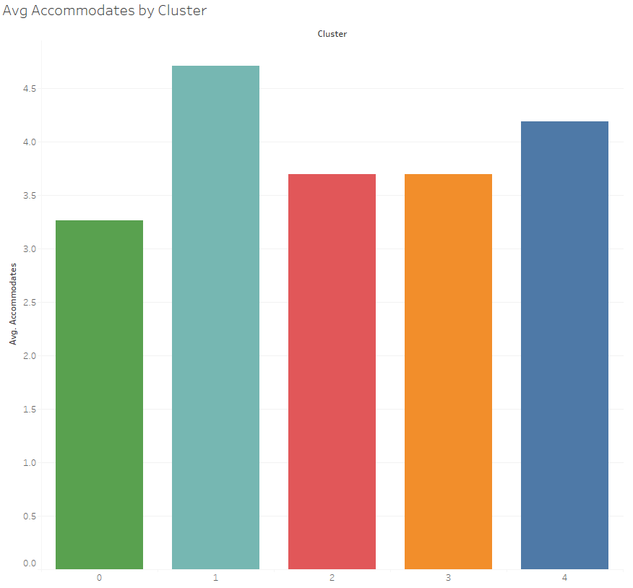
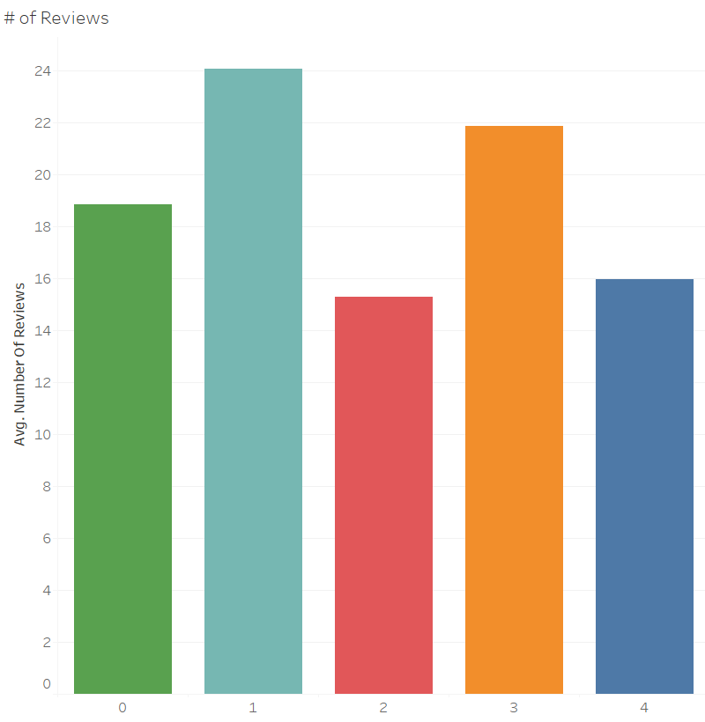
Results Interpretation

Slide 22
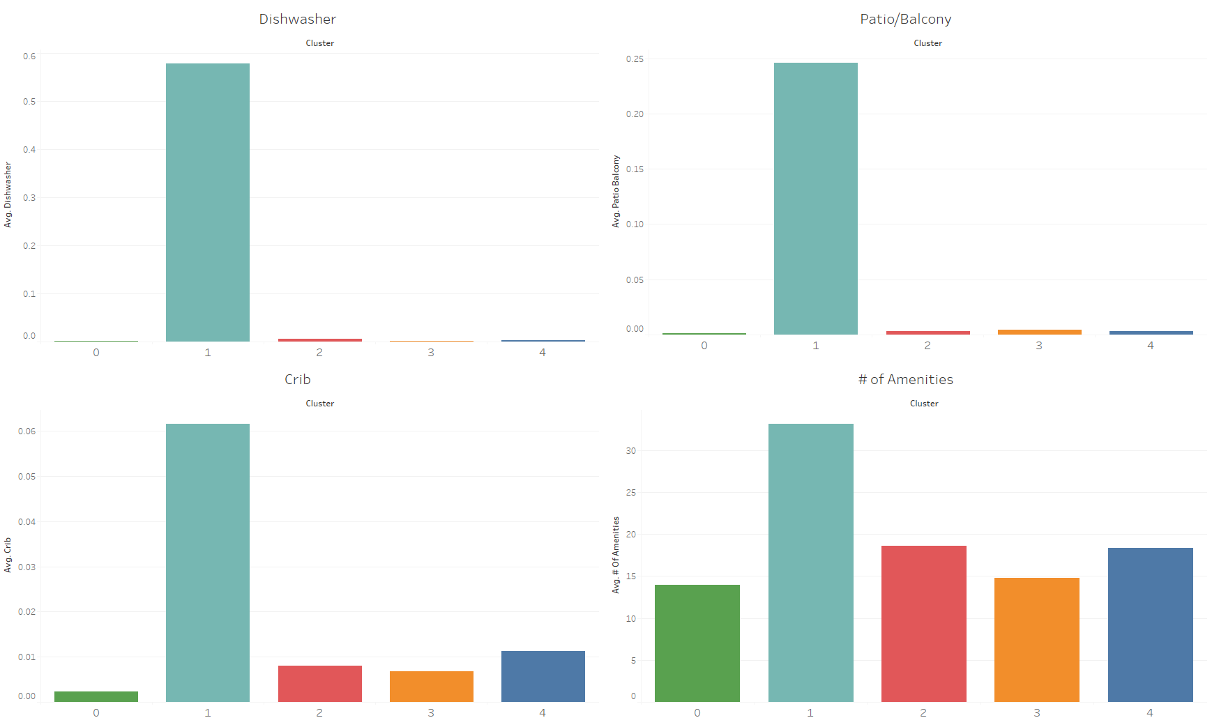
Results Interpretation

Slide 23
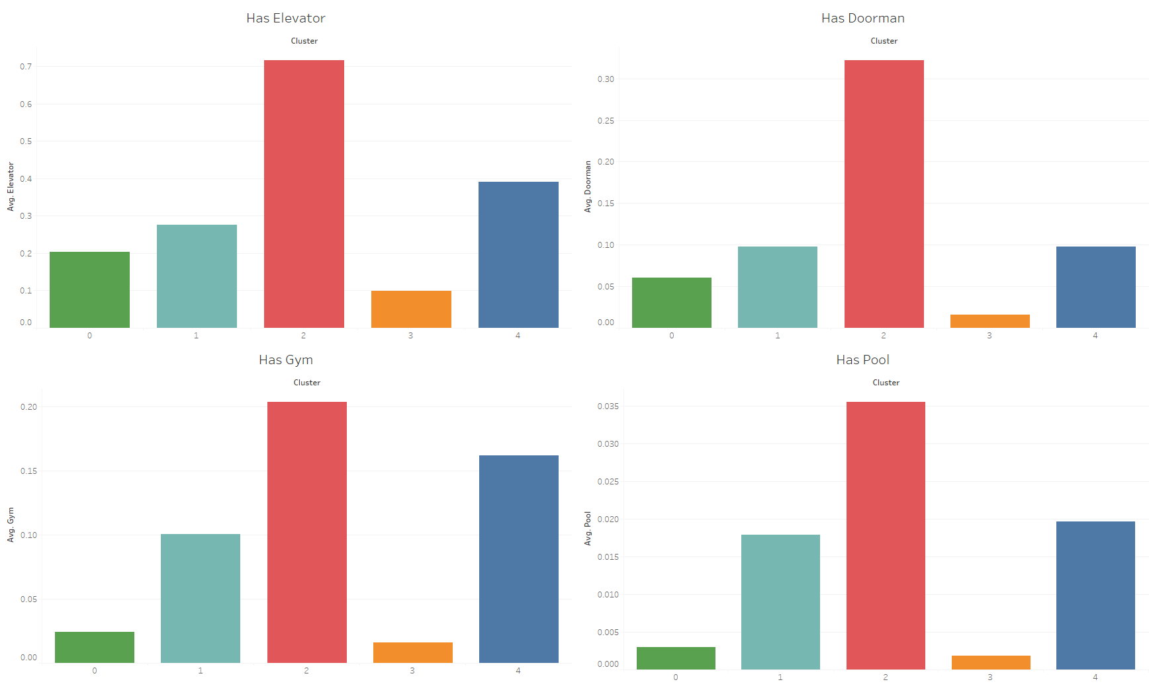
Results Interpretation

Slide 24
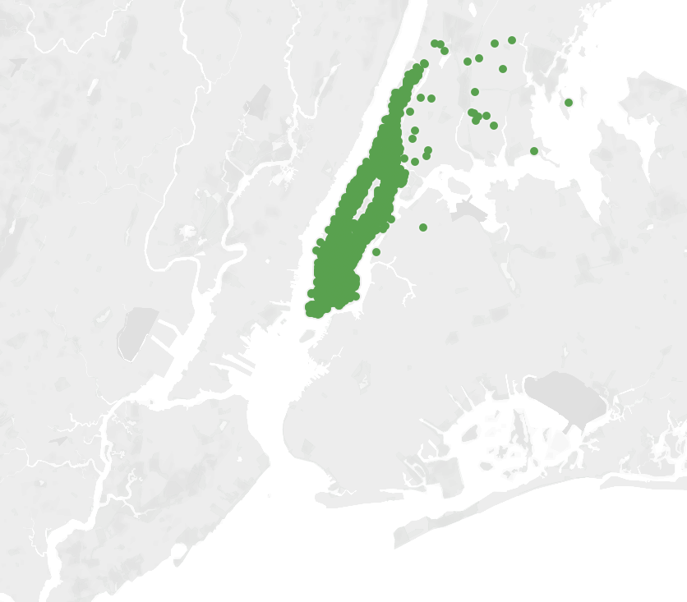
Cluster 0 – “Location Over Amenities”
99% Manhattan
Last in Avg # of Amenities
Lowest Avg # Accommodated
Least kid-friendly, least pet-friendly
Middle of the pack on average price
Most "small" words, "proximity" words, "nightlife" words, and "negative" words
Fewest "nature" words, "family" words, and "safety" words

Slide 25
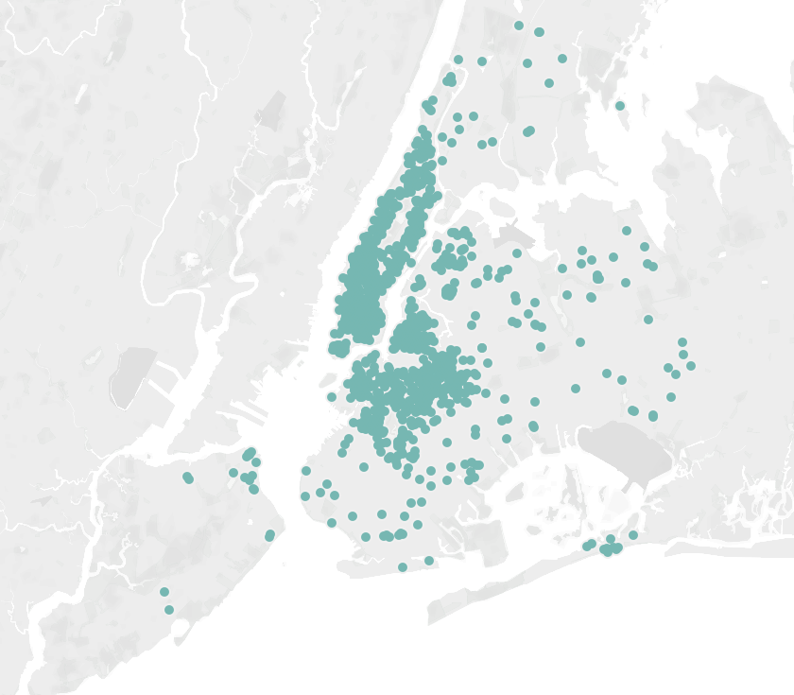
Cluster 1 – “Fully-loaded with Amenities”
Geographically spread, well-represented in all 5 boroughs
1st in # of amenities by almost double
Highest Avg # Accommodated
Newest average listings
Longest description lengths
10x or more leader in dishwashers, stoves/ovens, patios/balconies, 2x or more leader in another dozen amenity categories
Most avg. reviews / month (best available proxy for occupancy rate)
Most "updates" words, "family" words, "hip" words, "business" words, and "relaxation" words

Slide 26
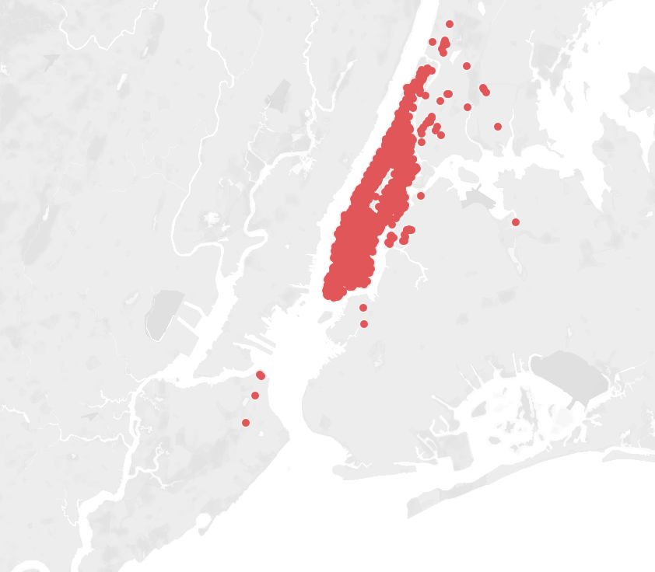
Cluster 2 – “Luxury Manhattan”
98% Manhattan
1st in all 4 building-specific amenities: Elevators, doormen, pools, and gyms
Highest average prices
Smallest # of reviews
Highest % of condos
Best for wheelchair accessibility
Most "luxury" words, "landmark" words, and "ease" words
Fewest "public transit" words, "nightlife" words, "hip" words, "small" words

Slide 27
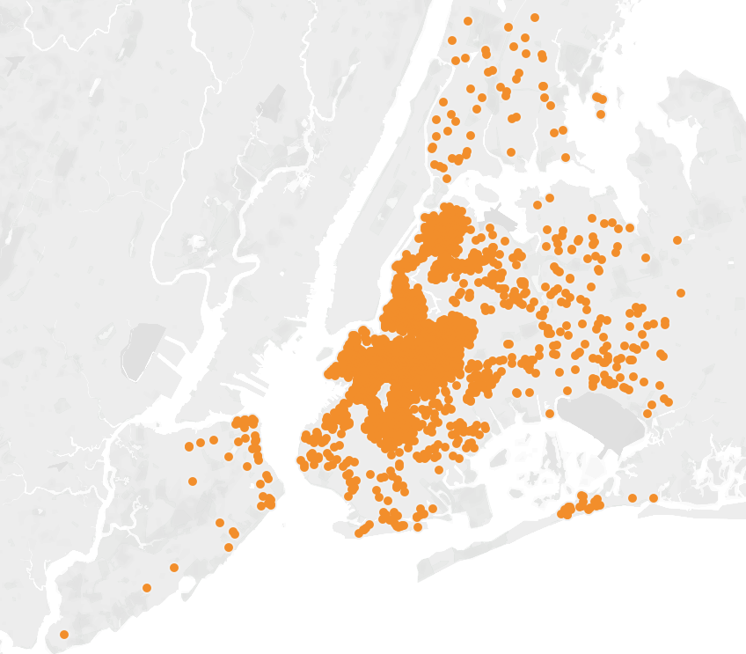
Cluster 3 – “Budget-friendly Outside Manhattan”
79% Brooklyn, 18% Queens
Lowest average prices
Lowest % Air Conditioned (still over 80%)
Smallest cluster
2nd lowest avg # of amenities
2nd "oldest" listings (days since first review)
Most "culture" words and "retail" words
Fewest "updates" words and "luxury" words

Slide 28
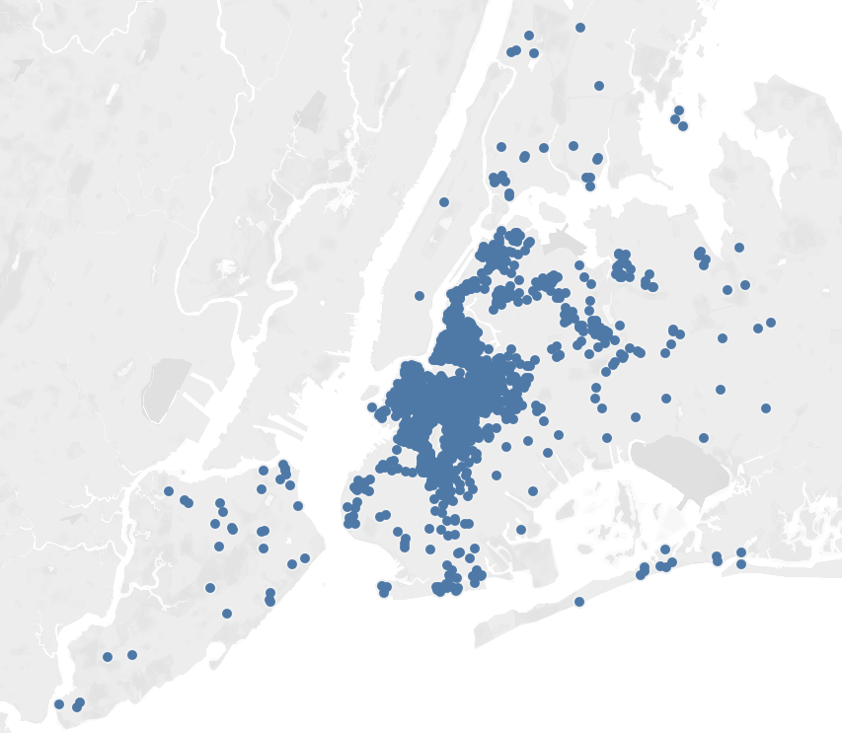
Cluster 4 – “Premium Outside Manhattan”
86% Brooklyn, 11% Queens
Most pet-friendly, most "pets on property"
2nd highest % of elevators, gyms, pools, wheelchair accessibility
"Oldest" listings (days since first review)
Highest # of lofts
Fewest avg. reviews / month (best available proxy for occupancy rate)
Most "view" words, "nature" words, 2nd most "family" words
Fewest "landmark" words, "tourism" words, "proximity" words, and "ease" words

Slide 29

Recommendations
Improve Airbnb's recommendation engine by comparing a user's historical rental behavior to cluster characteristics.
Previous rentals falling within a certain cluster
(or in the presence of more data)
Previous rentals showing preferences aligned with a certain cluster’s characteristics.
Ex: User has multiple instances of opting for staying outside a given city center but in larger, more well-appointed properties.
Cluster 4 rentals slotted higher on that users search results for "NYC"
Allow users to specify cluster-related preferences when they join
Interested in relaxation or maximizing sightseeing opportunities?
Their tendency to travel as a couple, a family, or solo.
Are owners getting the most out of their written descriptions? Could ask them if they forgot to include certain features common to their cluster.
Could help Airbnb identify owners whose rentals are over- or underpriced relative to the rest of their cluster.

Slide 30
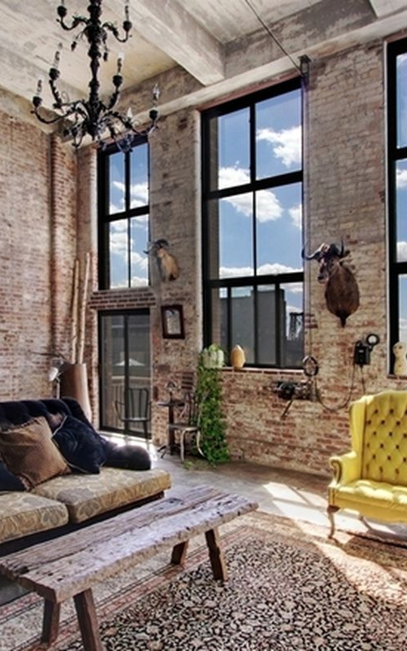
Model Improvements
Model performed well, but there are some changes or additions I would recommend if Airbnb wanted to further improve the clustering:
There are some additional rental data that could be useful to include if it exists, such as occupancy rate, and the full range of nightly rates for a property instead of simply an average.
Tune and perform hierarchical clustering to see if it might show improved performance over KMeans
Continue to grow the knowledge base of word groups by bringing in additional data. There are at least 11K more NYC rows in the Kaggle "Test" dataset alone, which are only missing price.

